Slide 1
Some String Program

Slide 2
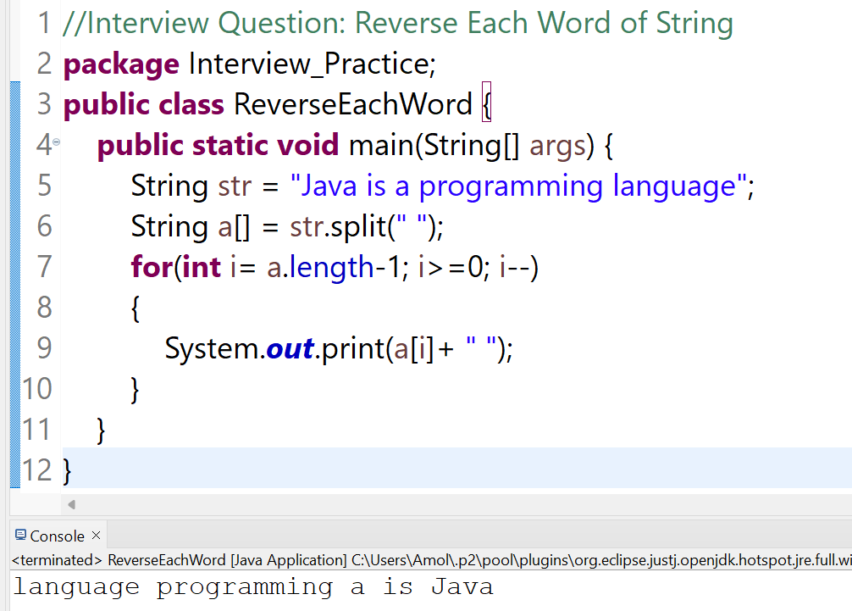
1. Reverse Each word of String

Slide 3
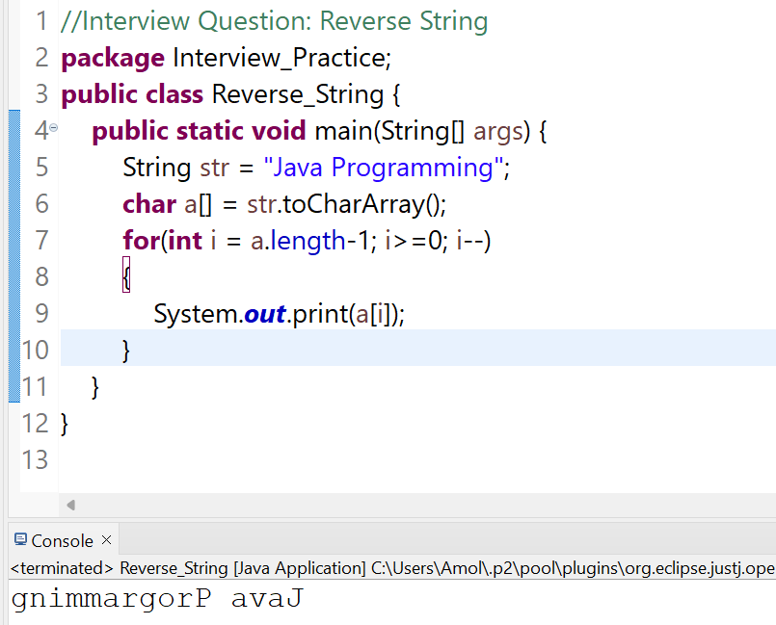
2. Reverse String

Slide 4
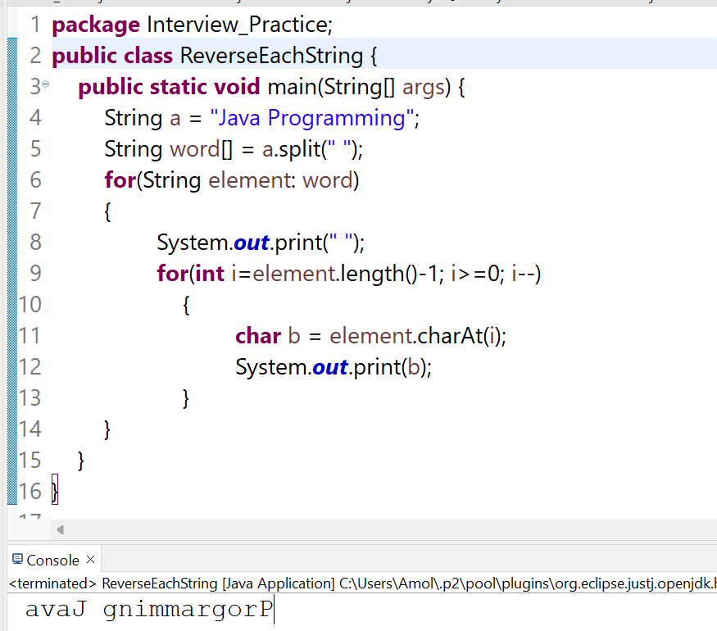
3. Reverse Each Individual Word of String

Slide 5
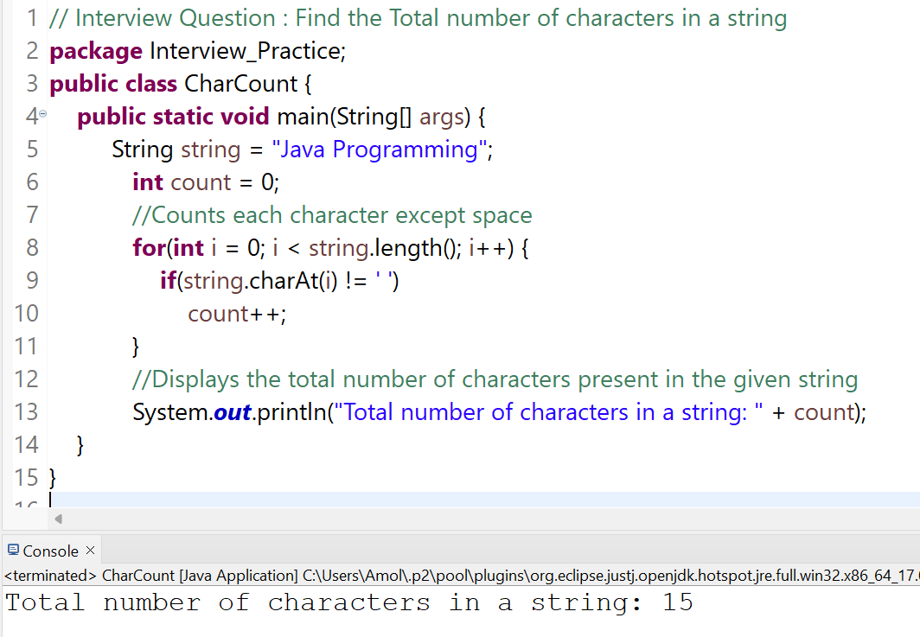
4, Find the Total Number of Character of String

Slide 6
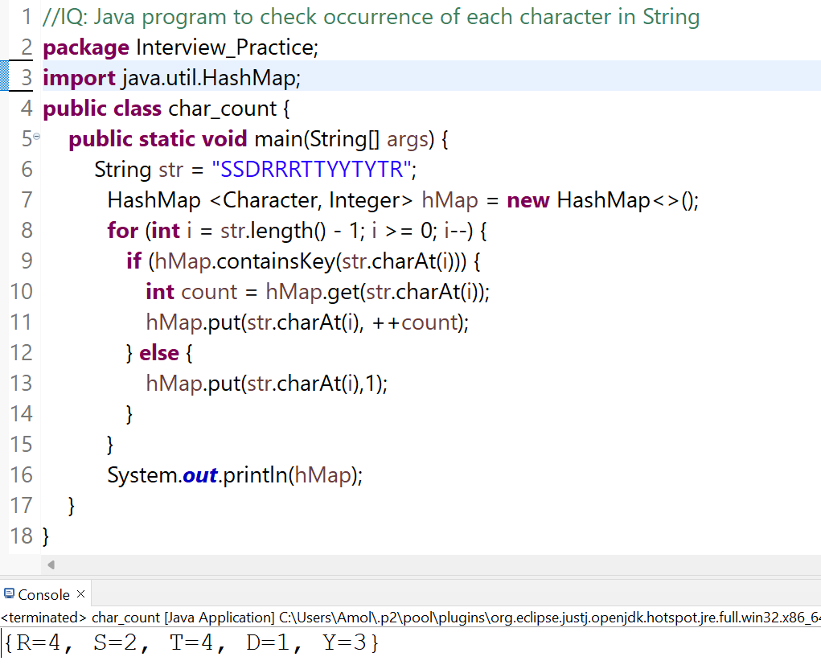
5. Java Program to check occurance of each characher

Slide 7
Thank You
Best of Luck

